Slide 1
Dynamic Spatiotemporal Graph Network for Traffic Accident
Risk Prediction
Name: ZHANG Pengcheng
Date: 2025/10/21

Slide 2
Contents
1
Introduction
2
Methods
3
Results
4
Discussion and conclusions

Slide 3
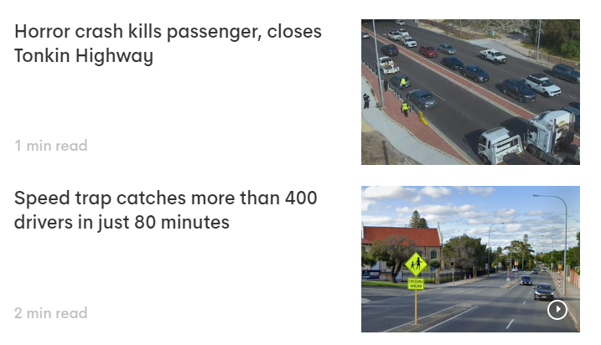
1.0
Background
Introduction
Statistics (2019-2023, Perth):
Total Crashes: 113,368
KSI (Killed or Seriously Injured): 5,432 (4% of crashes)
Fatalities: 295
Seriously Injured: 5,137
Road Safety Commission reported an annual economic loss of approximately AUD 2.7 billion across Western Australia.
Predicting traffic accidents and implementing targeted interventions is crucial for effective policy-making and government management.
(Source: https://7news.com.au/travel/perth-traffic)

Slide 4
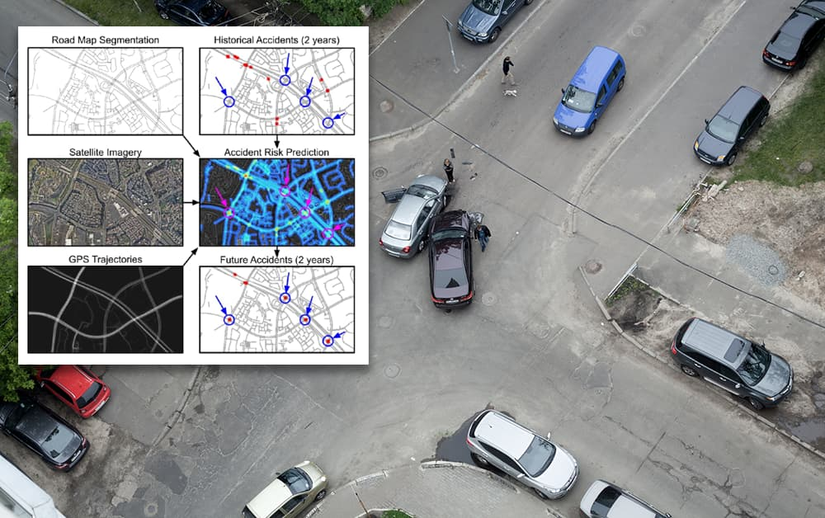
Challenges in Traffic Accident Prediction
Data Complexity: The interplay of various factors such as population, weather conditions, and urban infrastructure makes it difficult to model accident risks accurately.
Temporal Variability: Traffic patterns can change drastically over time (e.g., rush hours), requiring models to adapt dynamically to these fluctuations.
Spatial Dependencies: Accidents are influenced by local geographic features and nearby points of interest (POIs), necessitating sophisticated methods to capture these spatial relationships.
Integration of Diverse Sources: Combining diverse data types poses challenges in data preprocessing and feature extraction, complicating model development.
1.0
Introduction
https://www.thelickingnews.com/2023/03/15/

Slide 5
1.0
Introduction
Literature review
Approach | Description | Reference
Traditional Statistical Methods | Regression analysis, Bayesian networks, time series forecasting Limitations in handling nonlinear relationships and spatial dependencies | (Abdulhafedh, 2017; Chen et al., 2016).
Machine Learning Approaches | Decision trees, support vector machines, ensemble methods. Improved flexibility but often neglect spatial context | (Jamal et al., 2021)
Deep Learning Approaches | CNNs and LSTMs for capturing complex patterns. Integration of spatial and temporal features (e.g., GSNet, RiskOracle). | (Wang et al., 2021a; Zhou et al., 2020a)
Research Gap
Existing studies overlook complex spatiotemporal and semantic relationships, and lack integration of multi-source data feature extraction within a unified framework.

Slide 6
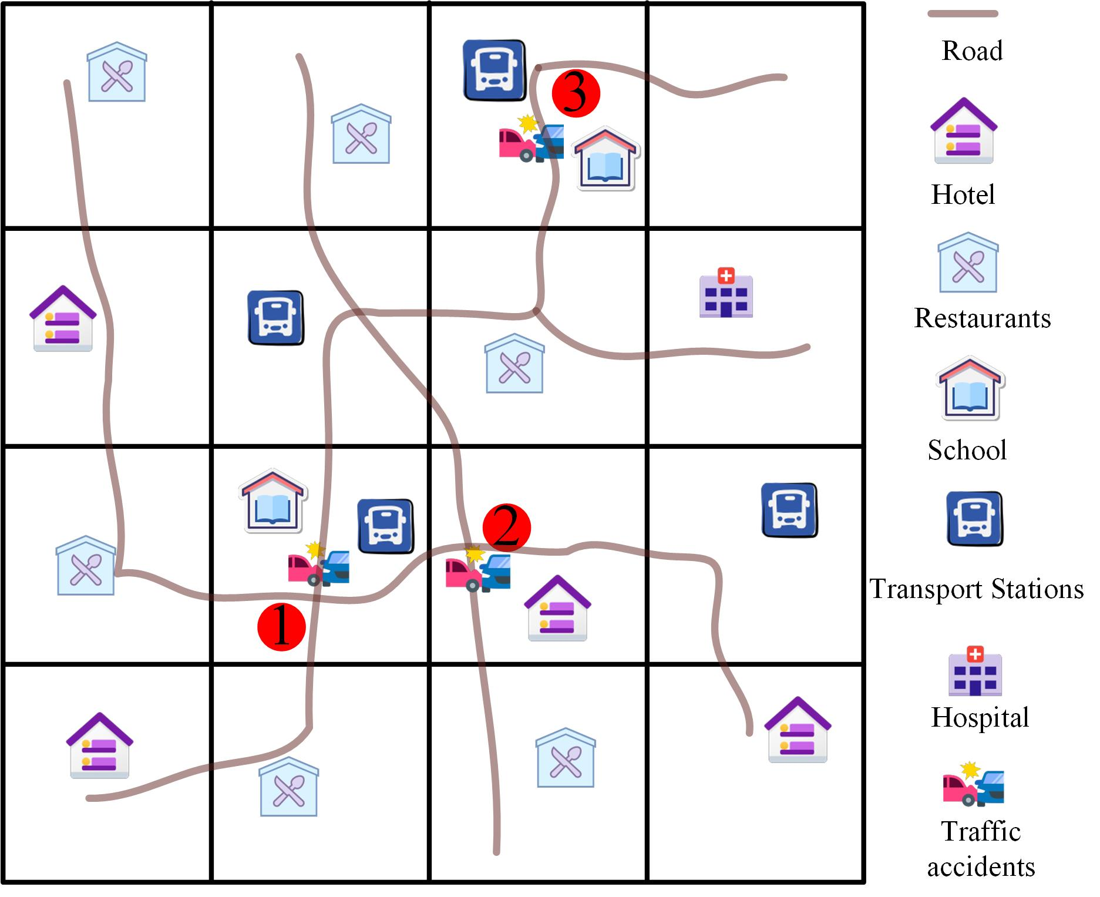
Problem Description
Spatial and Semantic Correlations:
Spatial Correlation:
Regions 1 and 2 are adjacent, increasing the likelihood of traffic accidents due to proximity.
Semantic Correlation:
Regions 1 and 3 share similar infrastructural features, making them equally prone to accidents.
Integration of Information:
Combines spatial and semantic data to predict traffic accident risks.
An example of using geographical and semantic spatial-temporal correlations to predict traffic accident risks.

Slide 7
1.0
Introduction
Research Aim and Objectives
Aim :To create a robust framework for predicting traffic accident risks that effectively captures spatial and temporal correlations to enhance urban safety.
Objectives
To develop a dynamic framework for accurately predicting traffic accident risks by capturing complex spatial and temporal patterns.
Integrate multi-source data, including traffic conditions, points of interest (POIs), population density, weather information, and road network characteristics, for improved accuracy.
Evaluate the model’s performance and compare it with state-of-the-art methods .

Slide 8
Contents
Contents
1
Introduction
2
Methods
3
Results
4
Discussion and conclusions

Slide 9
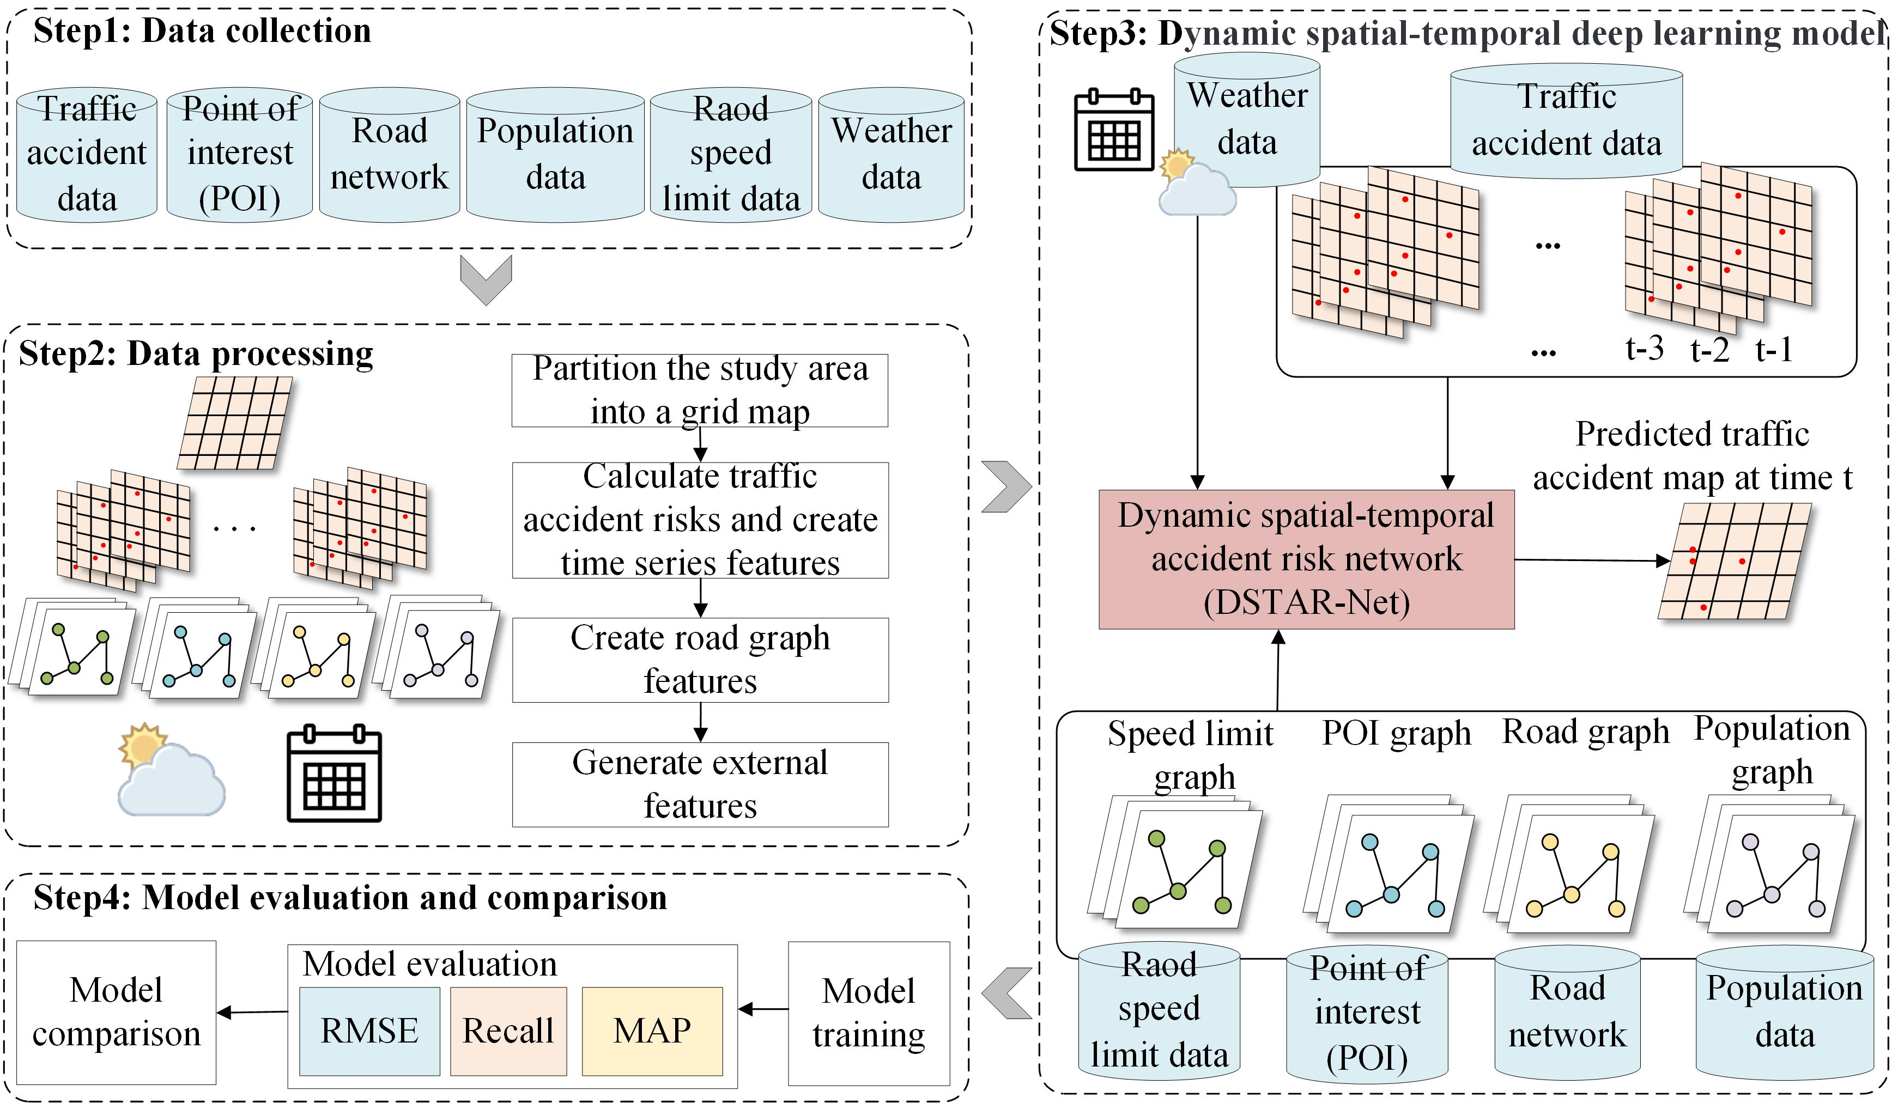
Methodology
Overall architecture

Slide 10
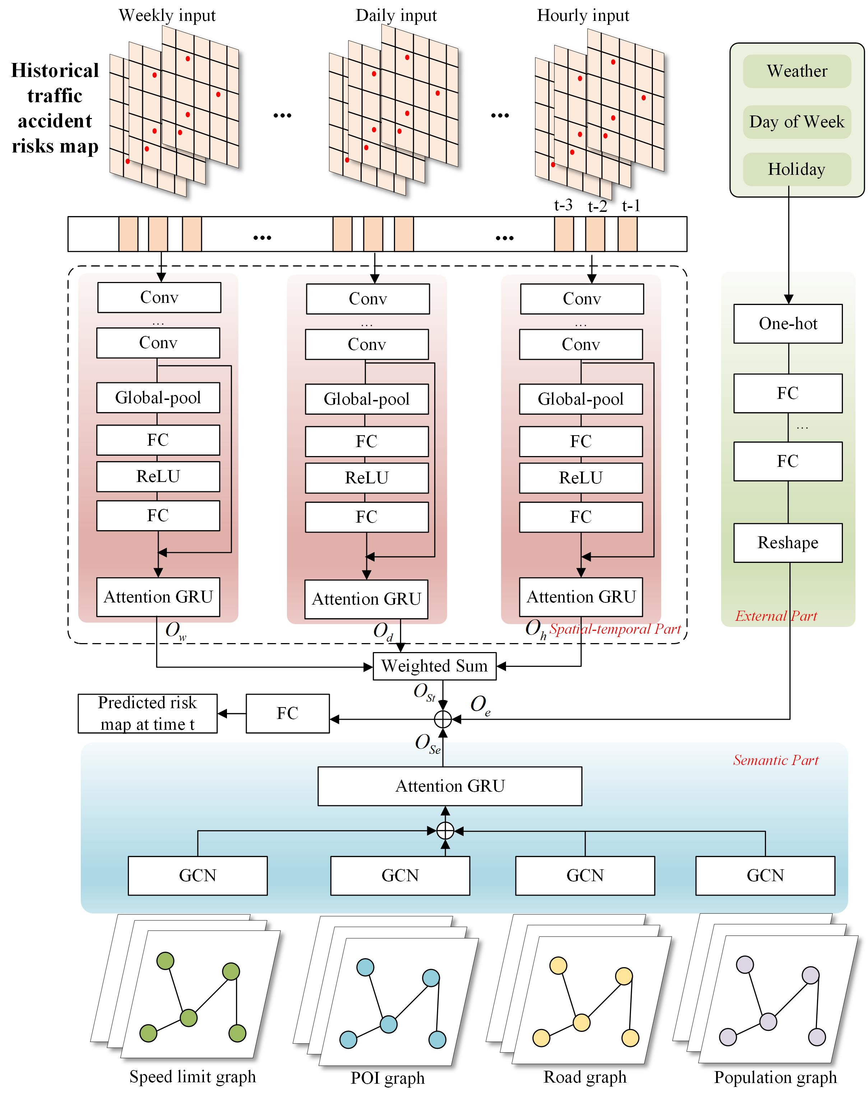
Methodology
Overall architecture
Structure of dynamic spatial-temporal accident risk network (DSTAR-Net)
Spatial-temporal part: designed to capture the spatial and temporal dependency between the grids of all regions.
Semantic part: to capture the dependency of semantic features
External part: incorporate external factors that influence traffic patterns, focusing on the day of week, holidays, and
weather conditions.

Slide 11
Contents
Contents
1
Introduction
2
Methods
3
Results
4
Discussion and conclusions

Slide 12
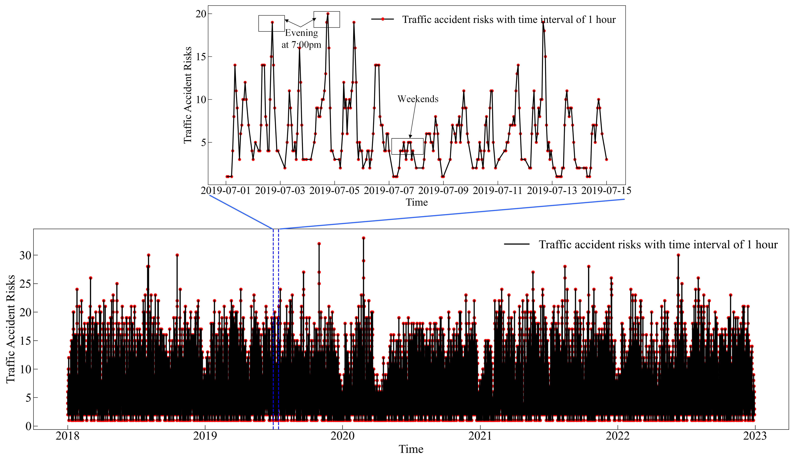
Study area and data
Traffic accidents from January 1, 2018, to December 31, 2022, comprising 109,670 traffic accidents
Peak Incidence:
Highest accident rates around 7 PM due to increased evening congestion.
Lowest Incidence:
Fewer accidents on weekends because of reduced traffic volume.

Slide 13
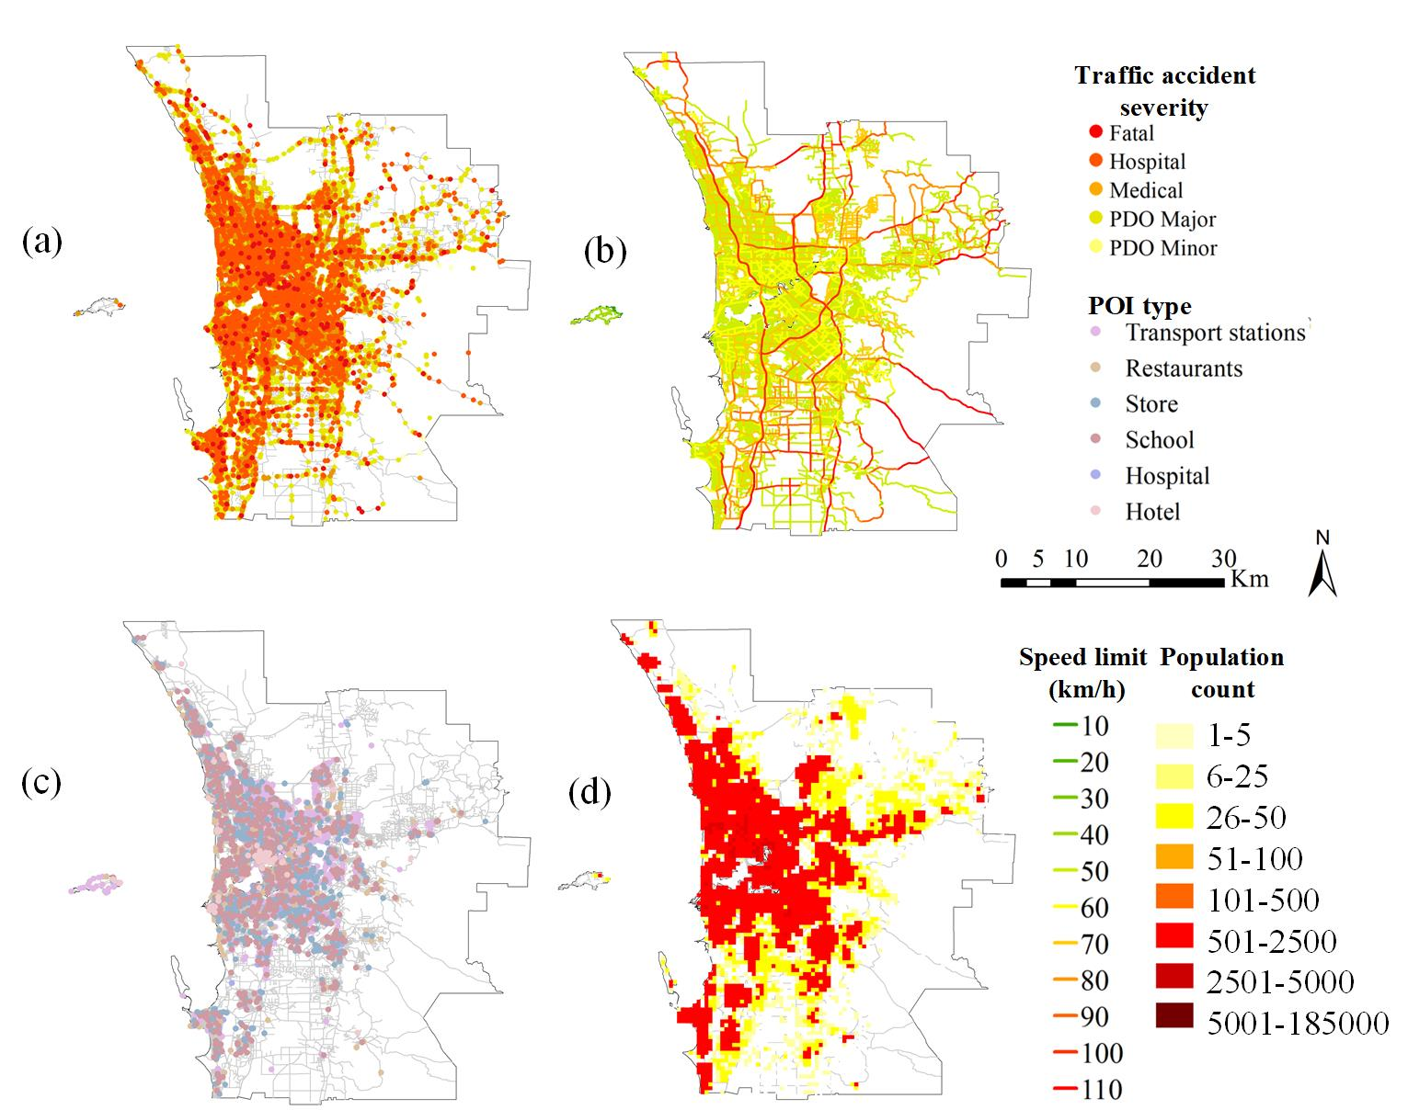
Study area and data
Accident Severity:
Concentrated in urban centers; sparse in outskirts.
Speed Limits:
Most roads have a speed limit of 50 km/h.
Points of Interest:
Concentrated in urban centers
Population Density:
High density in the western city center; decreases toward outskirts

Slide 14
Results
Models Comparison:
HA: Historical Average
LSTM: Long Short-Term Memory
ConvLSTM: Convolutional LSTM
GSNet: Geospatial Network
TWCCNet: Topographic Weighted Context Category
DSTAR-Net: Proposed Model
Evaluation Metrics:
RMSE
Recall
MAP
Advantages of DSTAR-Net:
Effectively captures spatial and temporal correlations.
Integrates various data sources for improved accuracy.

Slide 15
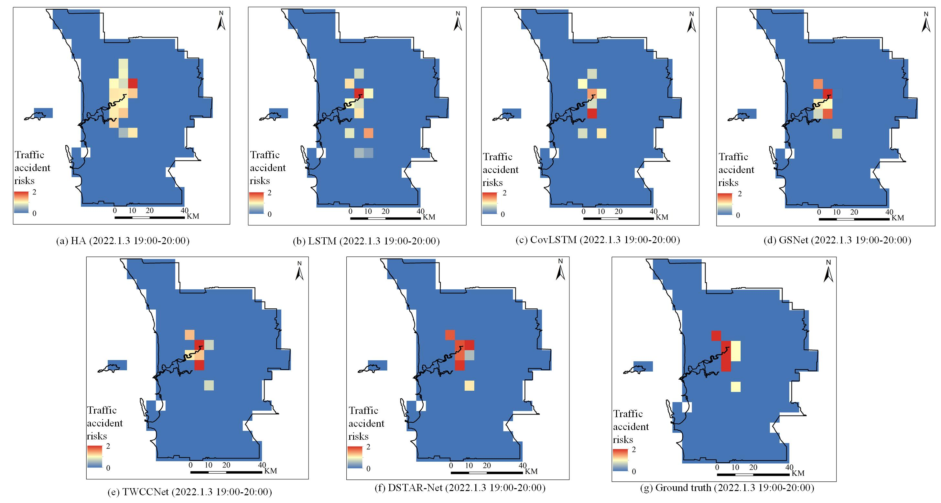
Results
Traditional Methods (HA, LSTM):
Ignore spatial factors; inaccuracies.
CNN-GCN Methods (GSNet, TWCCNet):
Higher accuracy in predicting locations and values.
DSTAR-Net:
Capturing complex spatial and temporal patterns. Uses multi-temporal dimensions for precise predictions.
Comparison maps of different methods of traffic accident risks between prediction and
ground truth: (a) HA prediction; (b) LSTM prediction; (c) CovLSTM prediction; (d) GSNet prediction; (e)TWCCNet prediction; (f) DSTAR-Net prediction; (g) ground truth.

Slide 16
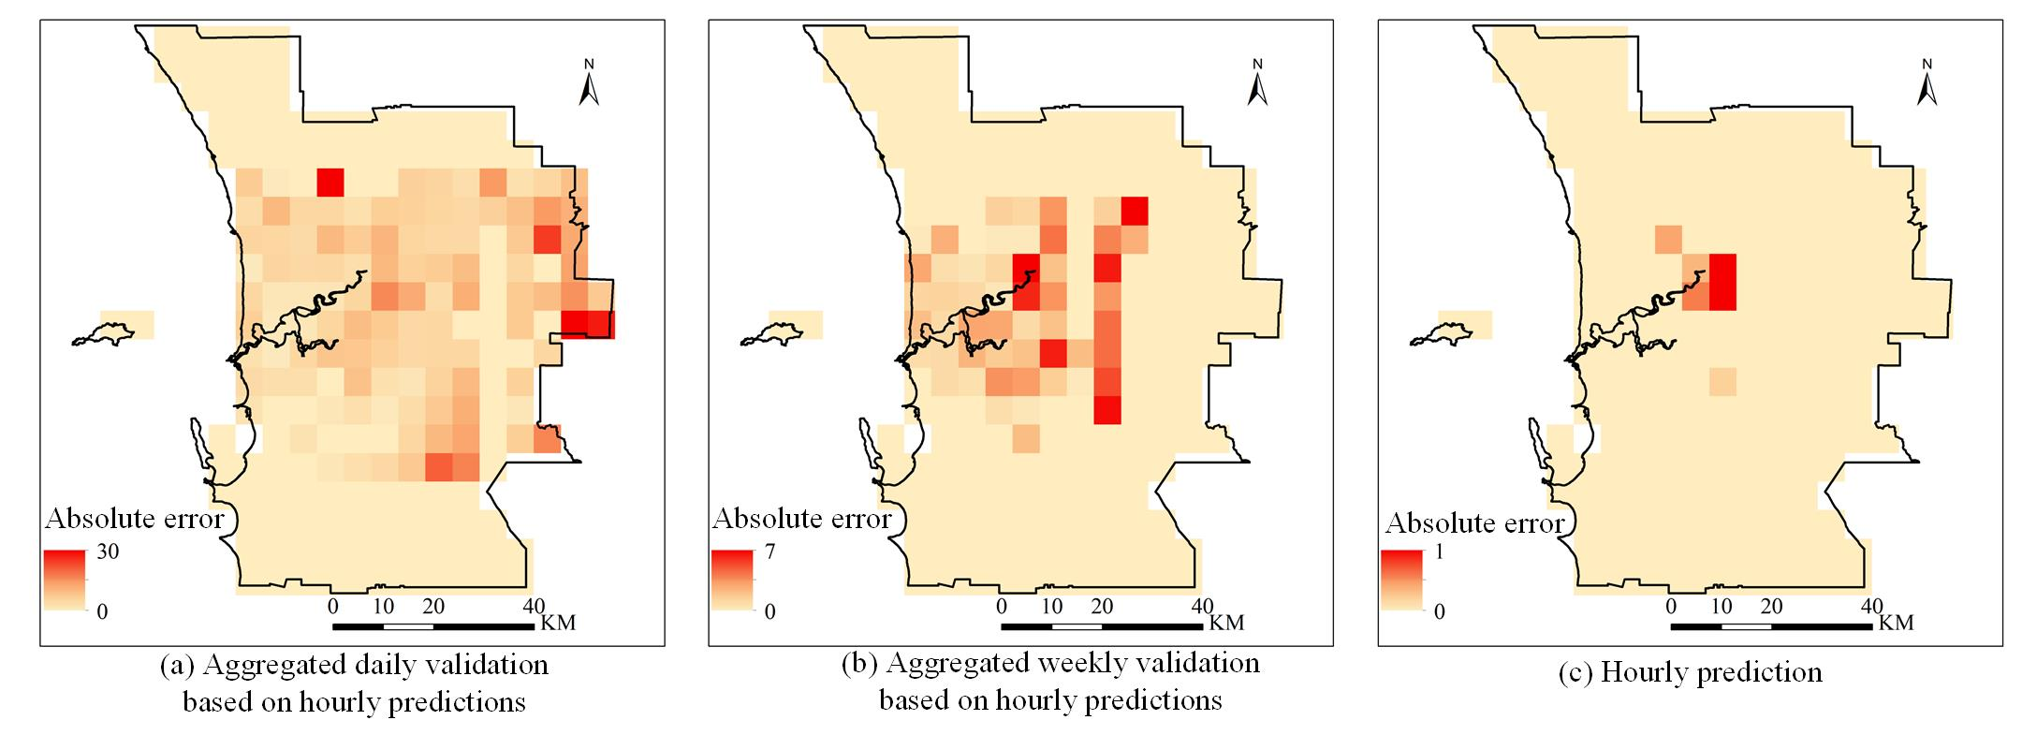
Results
The absolute error distribution maps
City Center:
Better performance due to:
Dense road networks.
Rich road features.
Higher traffic accident frequencies.
City Edge:
Greater errors due to:
Sparse road features.
Lower traffic volumes.
Random accident occurrences.
The absolute error distribution maps are presented for (a) aggregated daily validation based on hourly predictions; (b) aggregated weekly validation based on hourly predictions; and (c) hourly prediction.

Slide 17
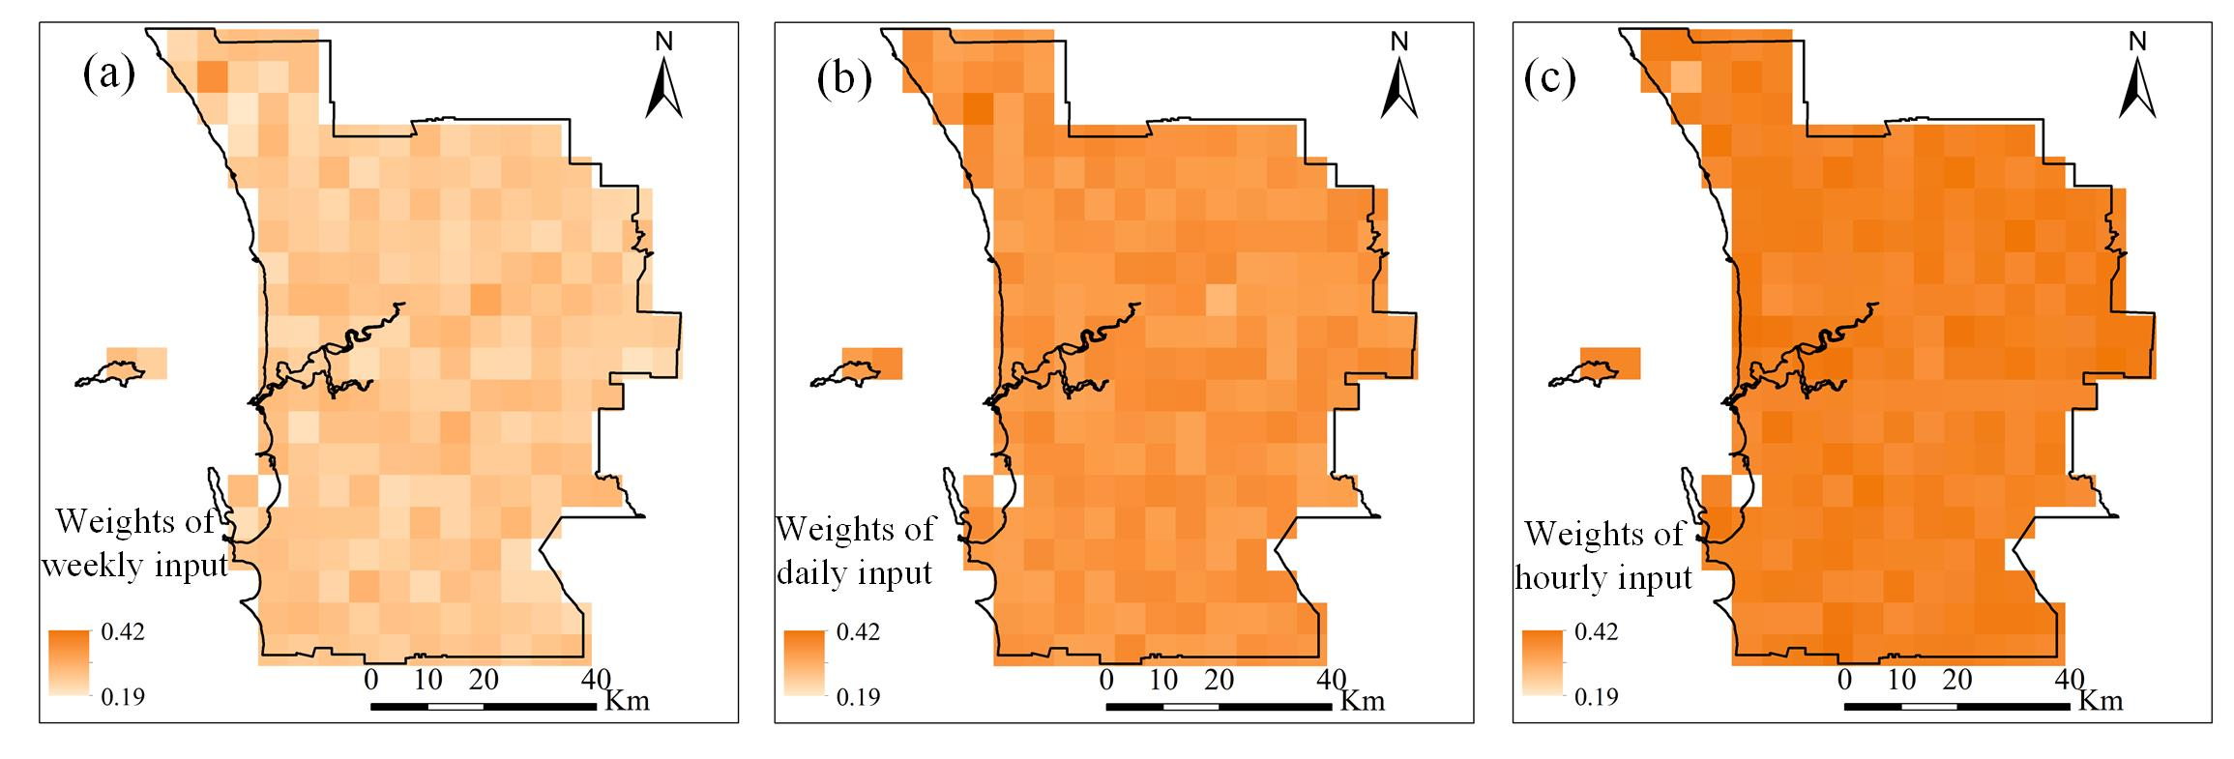
Results
Input Weights in DSTAR-Net
Average Weights:
Hourly Input: 0.390 (highest)
Daily Input: 0.355
Weekly Input: 0.255
Short-Term Influence:
Hourly factors are most significant for predicting traffic accidents.
Daily and weekly factors, while influential, are less critical for immediate predictions.
Spatial distribution of weights for different inputs of the DSTAR-Net: (a) weekly input, (b) daily input, (c) hourly input.

Slide 18
Contents
Contents
1
Introduction
2
Methods
3
Results
4
Discussion and conclusions

Slide 19

Conclusion
4.0
Conclusion
DSTAR-Net is proposed based on spatial and semantic features to enhance traffic accident risk prediction.
Traffic accident risk prediction
The model integrates multi-source data, including traffic conditions, points of interest (POIs), population density, weather information, and road network characteristics, for improved accuracy.
Accident prediction accuracy in areas with limited data needs improvement, highlighting opportunities for future research.

Slide 20
Thanks for listening！ Q & A

